Slide 1

Day 4 of learning Python

Slide 2
Content Review
Pandas
  What it is and its uses
  Examples
Cartopy
  What it is and its uses
  Examples

Slide 3

Pandas(Python for data analysis)
Python Open Source library that gives structure to data for data analysis.
Organize data into a data frames.
Load, repair, manipulate and analyze data(join data, merge, reshape, taking data from different data bases) all using the data frame structure
Can be easily visualized.
Derived from an Econometric term called PANel DAta
NumPy (Numerical Python NumPy; array based or matrix based calculations and data analysis, do complex calculations very easily
NumPy works with arrays while pandas with data frames and series
NumPy is best suited for working with homogeneous data while pandas best suited for working with tabular or heterogenous data

Slide 4
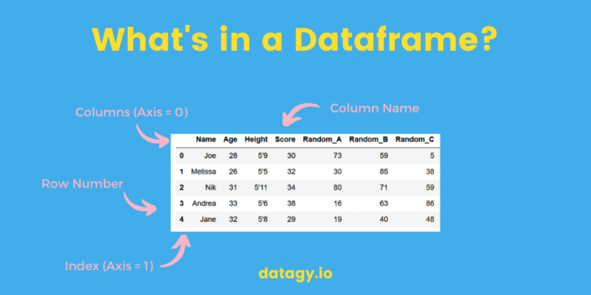
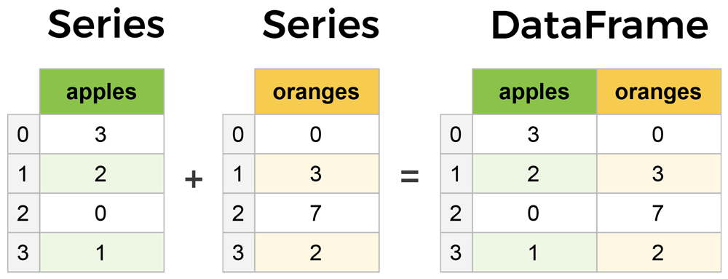

Slide 5
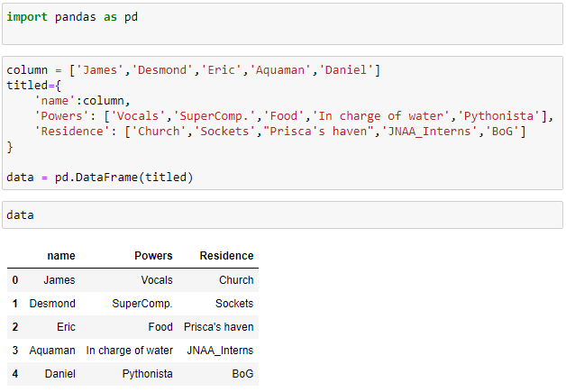

Slide 6
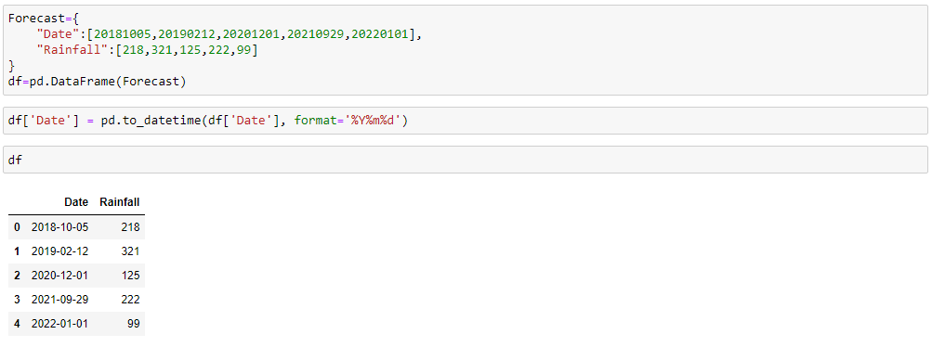

Slide 7
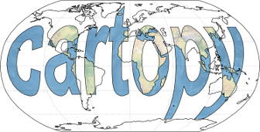
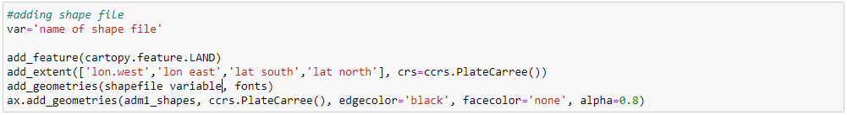
Cartopy is a Python package designed for geospatial data processing in order to produce maps and other geospatial data analyses.
We can perform many functions like geometries, extent, and even add features details like oceans, land, boundaries with the cartopy.feature.object command. E.g.;

Slide 8
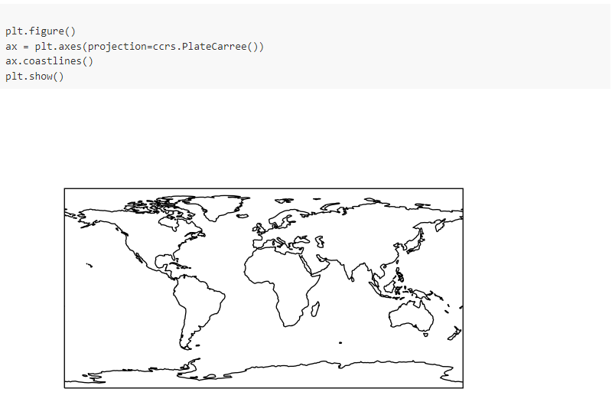

Slide 9
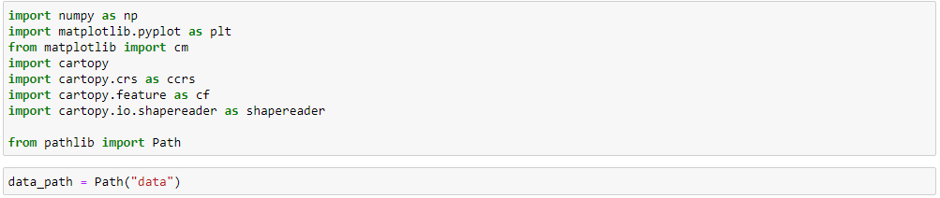
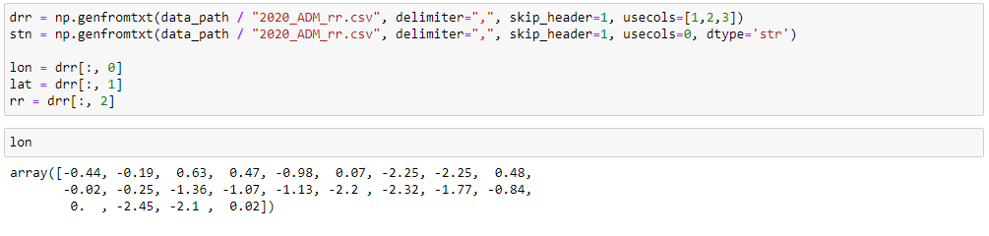

Slide 10
